Slide 1
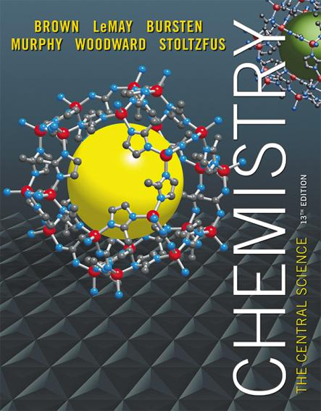
Lecture Presentation
Chapter 7 Periodic Properties of the Elements

Slide 2
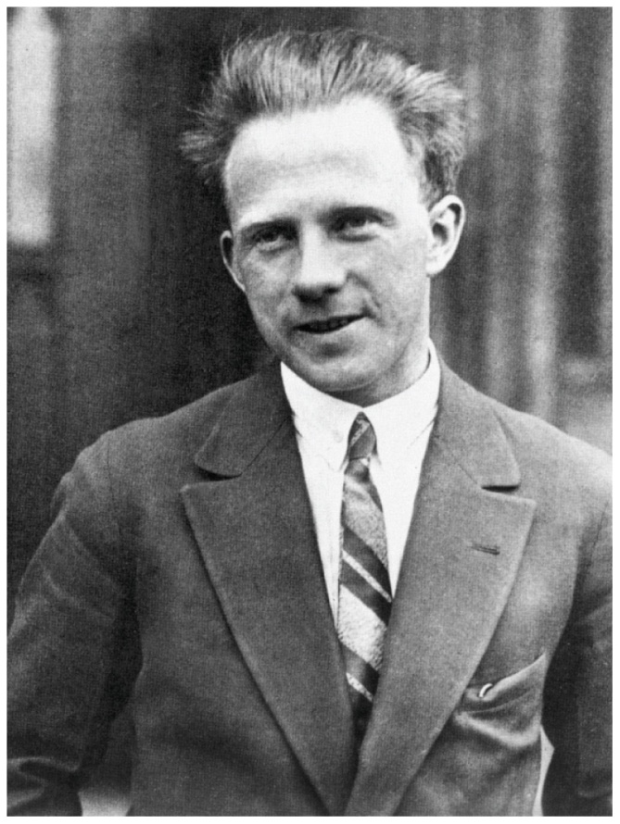
The Uncertainty Principle
Heisenberg showed that the more precisely the momentum of a particle is known, the less precisely is its position is known:
h
4π
(Δx) (Δmv) ≥
Notes:
Two slit interference

Slide 3
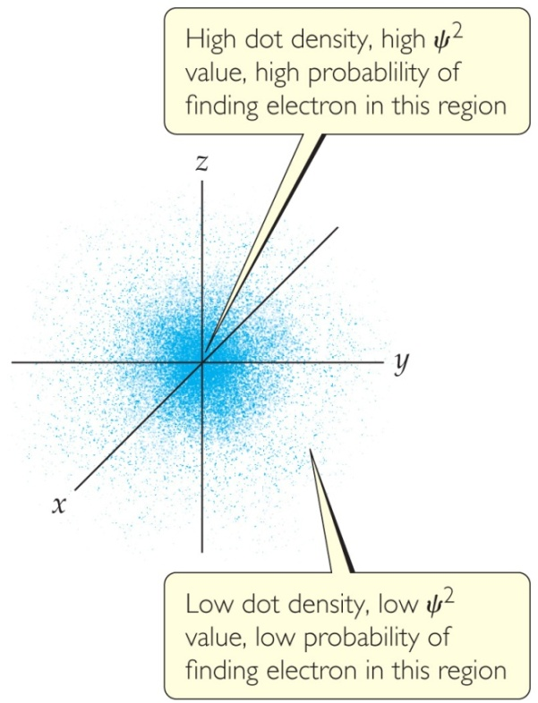
Quantum Mechanics
The solution of Schrödinger’s wave equation is designated with a lowercase Greek psi (ψ).
The square of the wave equation, ψ², gives the electron density, or probability of where an electron is likely to be at any given time.

Slide 4
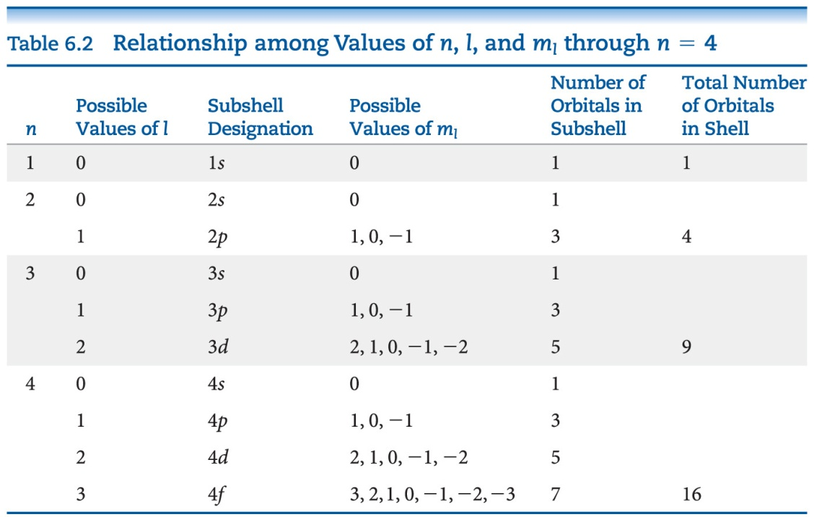
Magnetic Quantum Number (m_{l})
Orbitals with the same value of n form an electron shell.
Different orbital types within a shell are subshells.

Slide 5
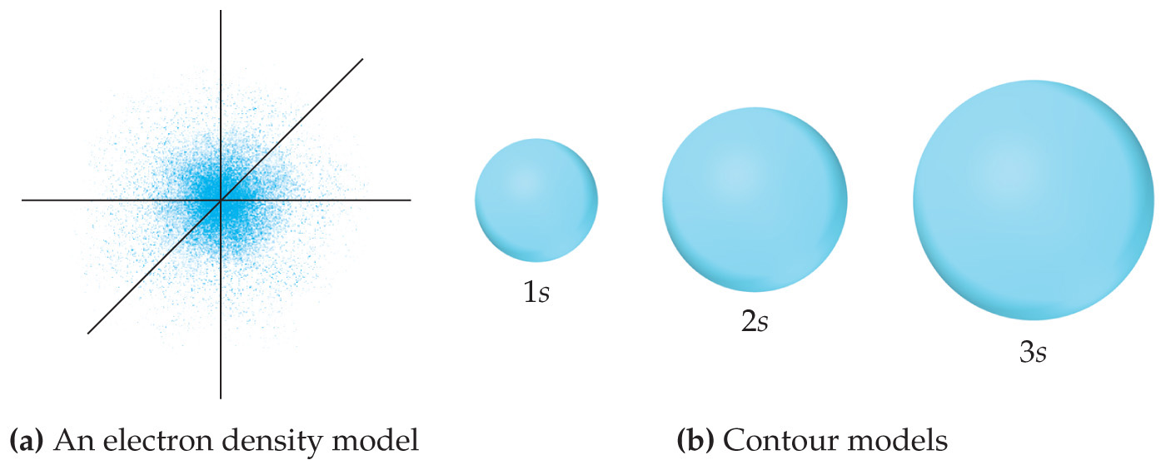
s Orbitals
The value of l for s orbitals is 0.
They are spherical in shape.
The radius of the sphere increases with the value of n.

Slide 6
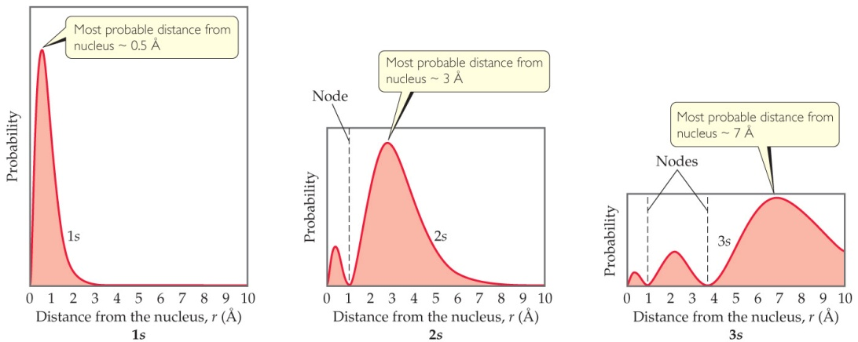
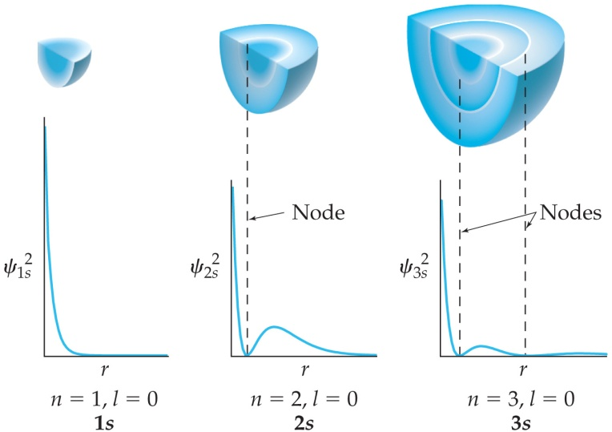
s Orbitals
For an ns orbital, the number of peaks is n.
For an ns orbital, the number of nodes (where there is zero probability of finding an electron) is n – 1.
As n increases, the electron density is more spread out and there is a greater probability of finding an electron further from the nucleus.

Slide 7
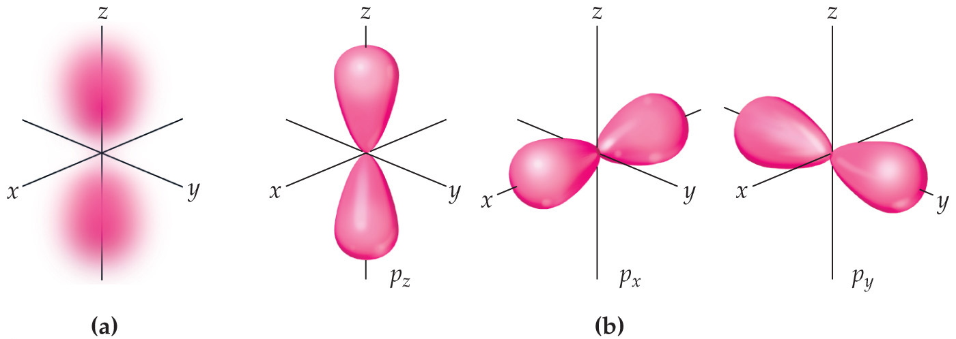
p Orbitals
The value of l for p orbitals is 1.
They have two lobes with a node between them.

Slide 8
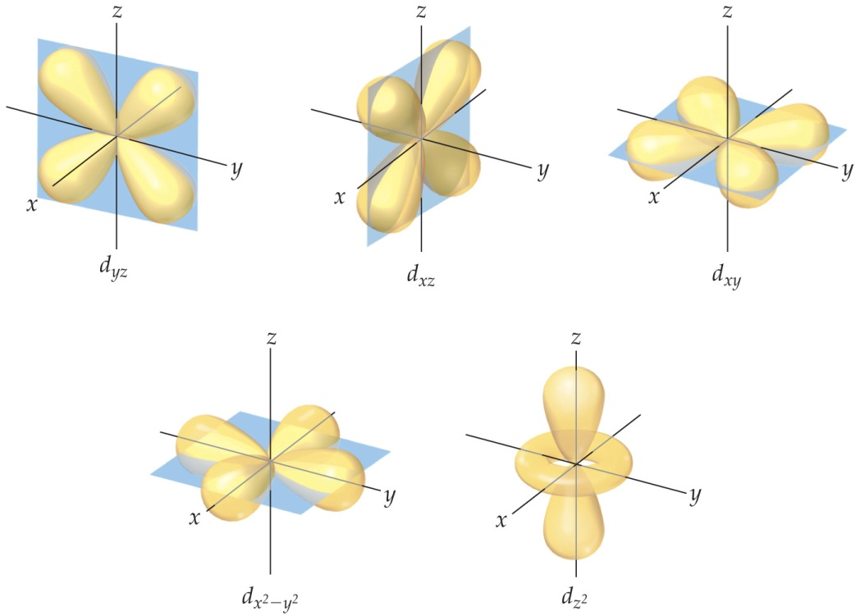
d Orbitals
The value of l for a d orbital is 2.
Four of the five d orbitals have four lobes; the other resembles a p orbital with a doughnut around the center.

Slide 9
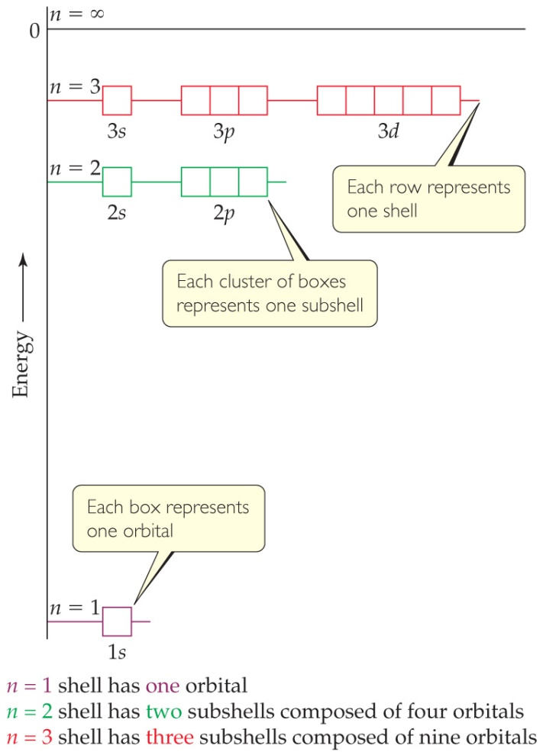
Energies of Orbitals—Hydrogen
For a one-electron hydrogen atom, orbitals on the same energy level have the same energy.
Chemists call them degenerate orbitals.

Slide 10
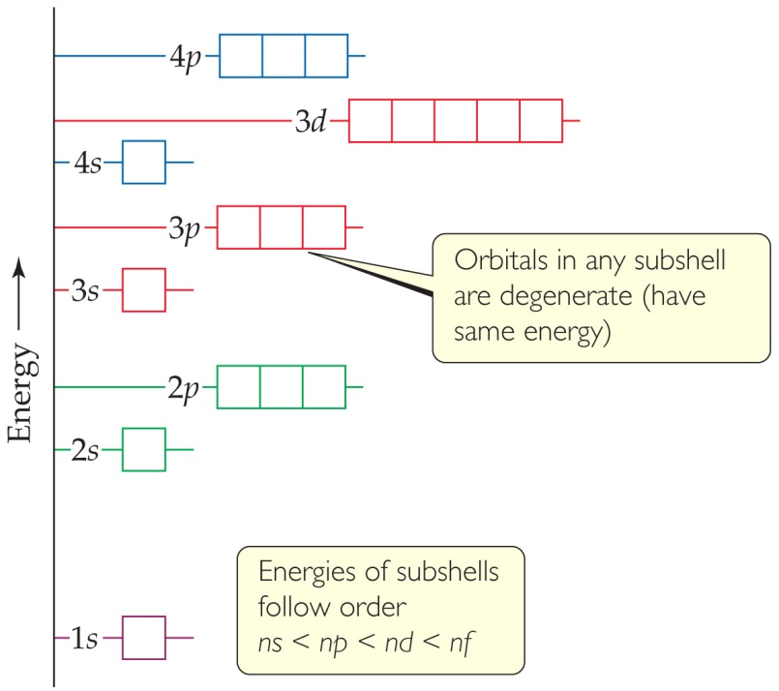
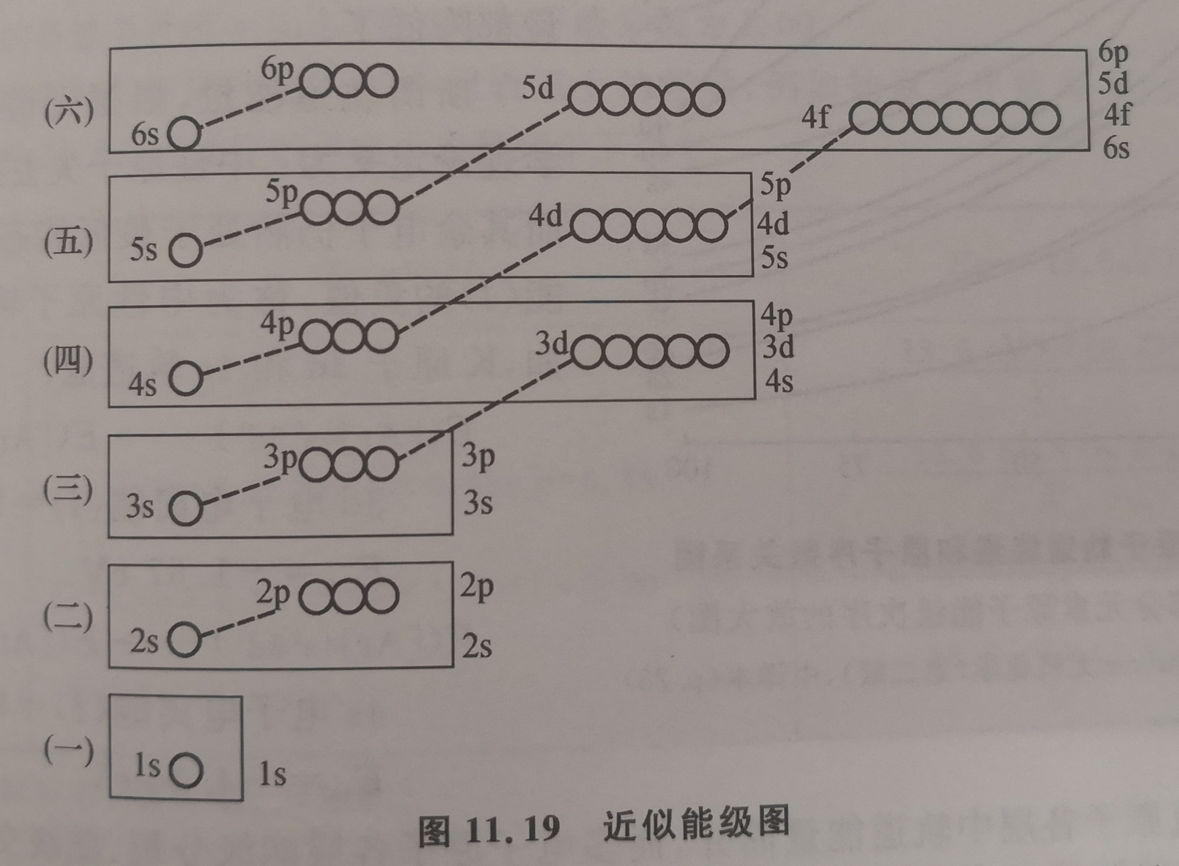
Energies of Orbitals— Many-electron Atoms
As the number of electrons increases, so does the repulsion between them.
Therefore, in atoms with more than one electron, not all orbitals on the same energy level are degenerate.
Orbital sets in the same sublevel are still degenerate.
Energy levels start to overlap in energy (e.g., 4s is lower in energy than 3d.)

Slide 11
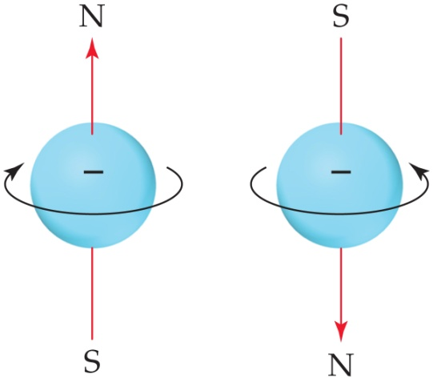
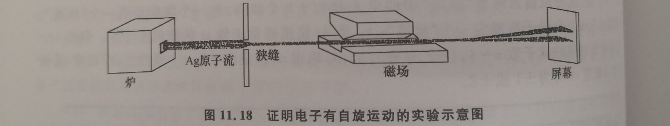
Spin Quantum Number, m_{s}
In the 1920s, it was discovered that two electrons in the same orbital do not have exactly the same energy.
The “spin” of an electron describes its magnetic field, which affects its energy.
This led to the spin quantum number, m_{s}.
The spin quantum number has only two allowed values, +½ and –½.

Slide 12
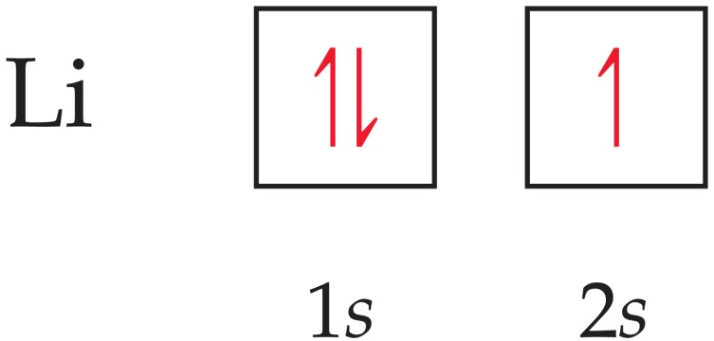
Pauli Exclusion Principle
No two electrons in the same atom can have exactly the same energy.
Therefore, no two electrons in the same atom can have identical sets of quantum numbers.
This means that every electron in an atom must differ by at least one of the four quantum number values: n, l, m_{l}, and m_{s}.

Slide 13
Electron Configurations
The way electrons are distributed in an atom is called its electron configuration.
The most stable organization is the lowest possible energy, called the ground state.
Each component consists of
a number denoting the energy level;
a letter denoting the type of orbital;
a superscript denoting the number of electrons in those orbitals.
4p⁵

Slide 14
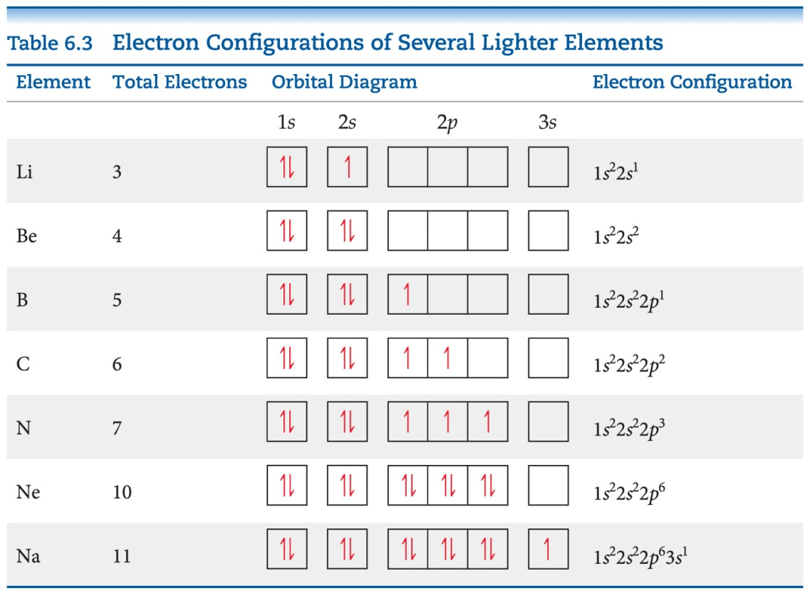
Hund’s Rule
“For degenerate orbitals, the lowest energy is attained when the number of electrons with the same spin is maximized.”
This means that, for a set of orbitals in the same sublevel, there must be one electron in each orbital before pairing and the electrons have the same spin, as much as possible.

Slide 15
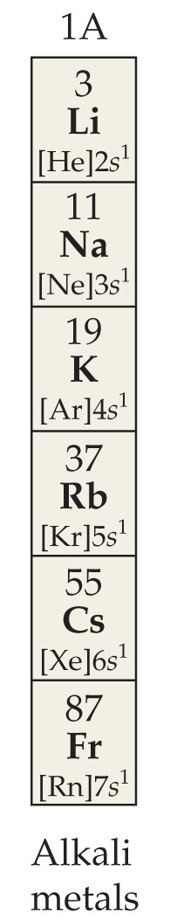
Condensed Electron Configurations
Elements in the same group of the periodic table have the same number of electrons in the outer most shell. These are the valence electrons.
The filled inner shell electrons are called core electrons. These include completely filled d or f sublevels.
We write a shortened version of an electron configuration using brackets around a noble gas symbol and listing only valence electrons.

Slide 16
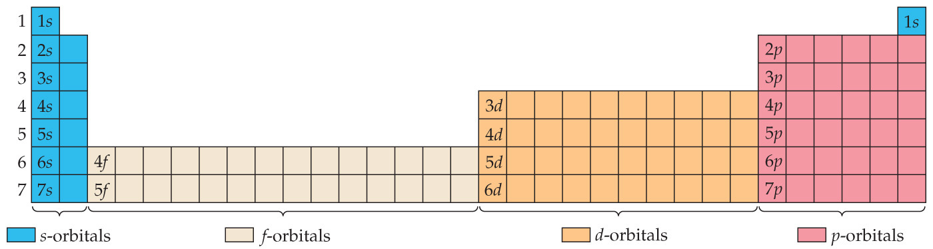
Periodic Table
We fill orbitals in increasing order of energy.
Different blocks on the periodic table correspond to different types of orbitals: s = blue, p = pink (s and p are representative elements); d = orange (transition elements); f = tan (lanthanides and actinides, or inner transition elements)

Slide 17
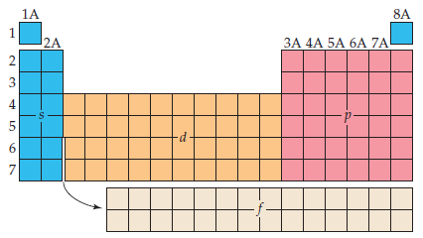
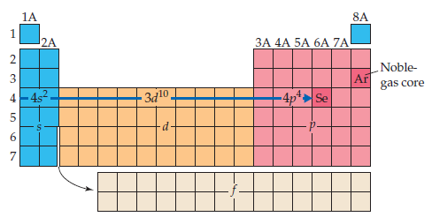

Slide 18
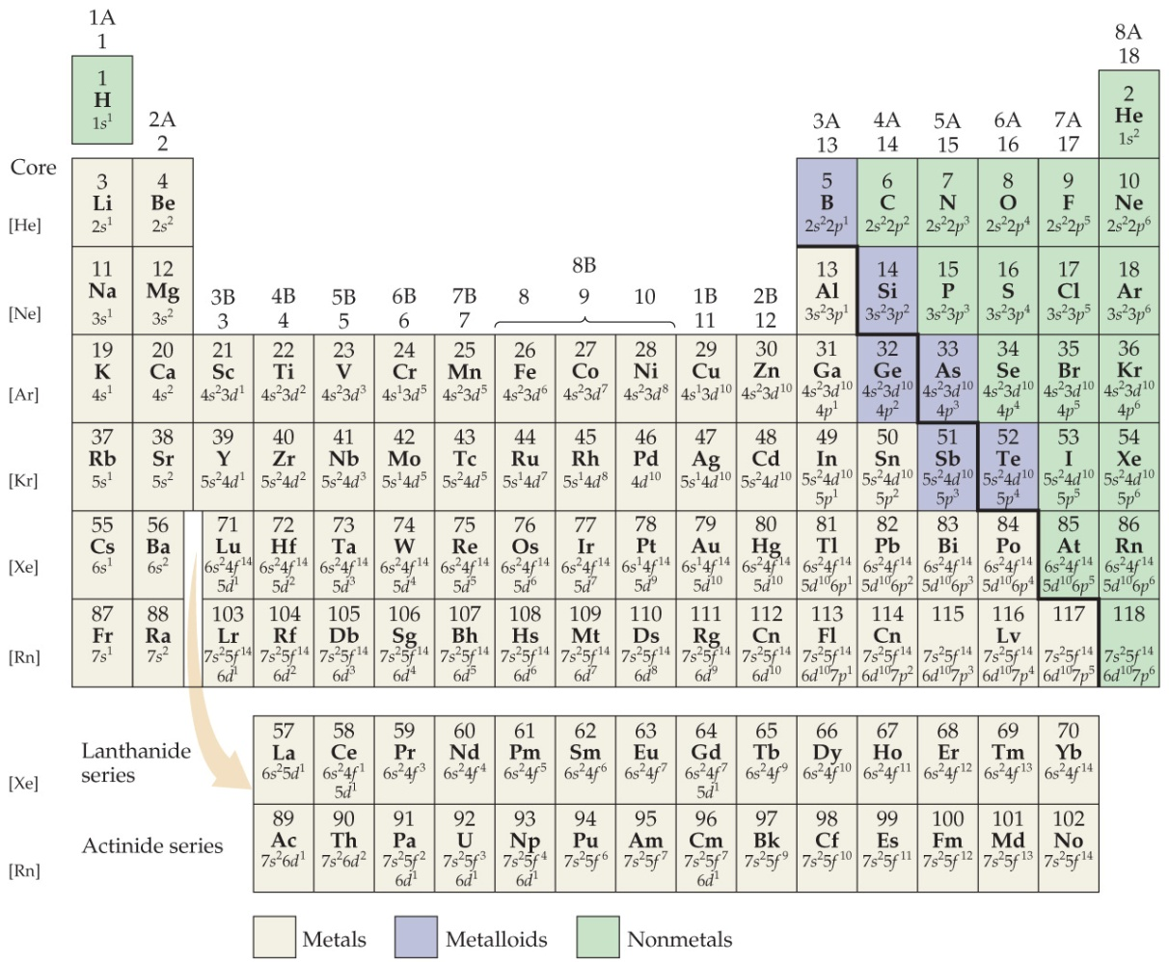
Some Anomalies
Some irregularities occur when there are enough electrons to half-fill s and d orbitals on a given row.

Slide 19
Chromium as an Anomaly
For instance, the electron configuration for chromium is
[Ar] 4s¹ 3d⁵ (half filled d orbital)
rather than the expected
[Ar] 4s² 3d⁴.
This occurs because the 4s and 3d orbitals are very close in energy.
These anomalies occur in f-block atoms with f and d orbitals, as well.

Slide 20
Why 4s subshell is filled before 3d but on ionization 4s electrons are removed first?
The rule: Filling up of orbitals is dependent on orbital energy while removal of electrons from orbitals is dependent on orbital location
4s has a lower energy than 3d, so it is filled up first.
4s is farther away from the nucleus than 3d.

Slide 21
Lecture Presentation
Chapter 7 Periodic Properties of the Elements

Slide 22
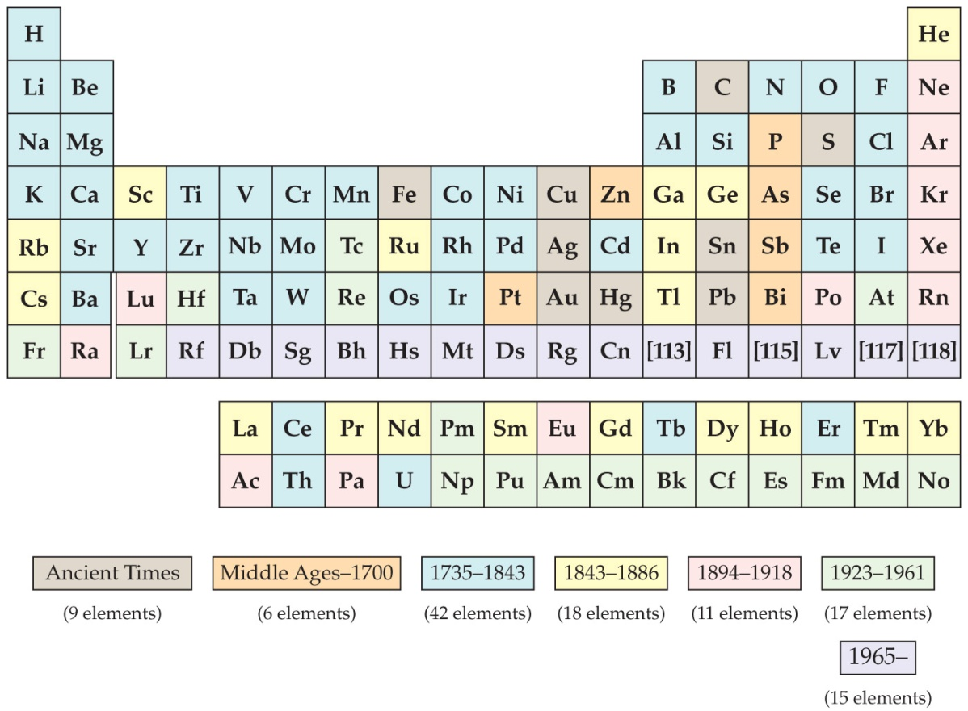
Development of the Periodic Table
Dmitri Mendeleev and Lothar Meyer independently came to the same conclusion about how elements should be grouped.
Notes:
Radium,1938, neuron bomboarding urium, 93/94, 56, nuclear fission.

Slide 23
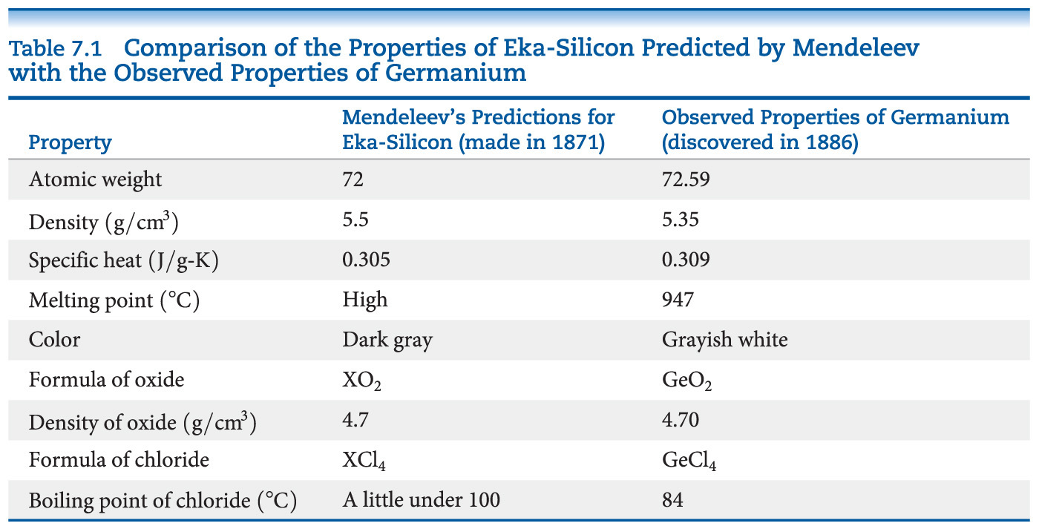
Mendeleev and the Periodic Table
Chemists mostly credit Mendeleev because he also used chemical properties to organize the table and predicted some missing elements and their expected properties, including germanium.

Slide 24
Atomic Number
Mendeleev’s table was based on atomic masses. It was the most fundamental property of elements known at the time.
About 35 years later, the nuclear atom was discovered by Ernest Rutherford.
Henry Moseley developed the concept of atomic number experimentally. The number of protons was considered the basis for the periodic property of elements.

Slide 25
Periodicity
Periodicity is the repetitive pattern of a property for elements based on atomic number.
The following properties are discussed in this chapter:
Sizes of atoms and ions
Ionization energy
Electron affinity
Some group chemical property trends
First, we will discuss a fundamental property that leads to may of the trends, effective nuclear charge.

Slide 26
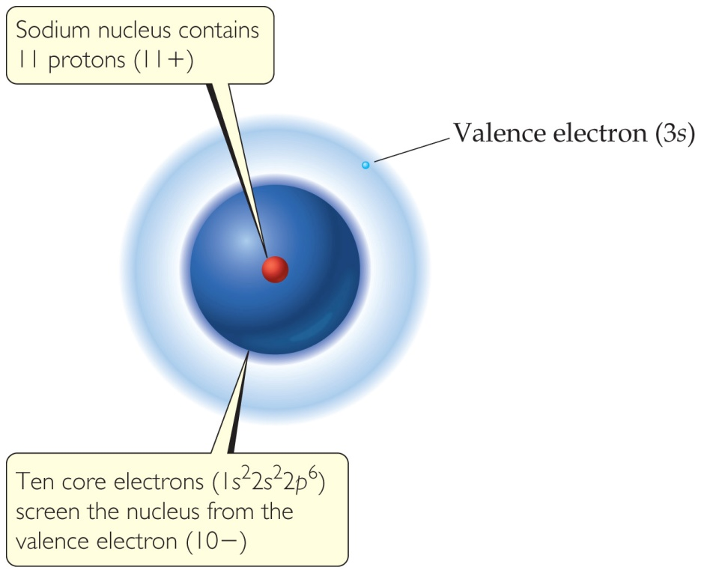
Effective Nuclear Charge
Many properties depend on attractions between valence electrons and the nucleus.
Electrons are both attracted to the nucleus and repelled by other electrons.
The forces an electron experiences depend on both factors.

Slide 27

Screening effect
e-
Valence electron
Core electrons
(screen)

Slide 28
Effective Nuclear Charge
The effective nuclear charge, Z_{eff}, is found this way:
Z_{eff} = Z − S
where Z is the atomic number and S is a screening constant, usually close to the number of inner electrons.
Effective nuclear charge is a periodic property:
It increases across a period.
It slightly increases down a group.
Notes:
Nuclear charge

Slide 29
Zeff
Na [Ne]3s¹; Z = 11+
Zeff = 11 – 10 = 1
The situation became more complicated if electron in what type of orbital is considered
For 3s electron in Na, it has small probability of being closer to the nucleus
Zeff = 11 – 8.5 = 2.5 +

Slide 30
S (Screening constant)
Zeff = Z – S (1e contributes 1.00)
Calculation by Slater rule (see textbook p. 262)
E.g Fluorine (1S²2S²2P⁵)
Calculation by Slater’s rule Zeff =9 – (0.35*6)-(0.85*2) = 5.2+
Calculation by Zeff = 9- 2 =7
Same n, 1e contributes 0.35;
n-1, 1e contributes 0.85;
Much inner shell,1e contributes 1

Slide 31
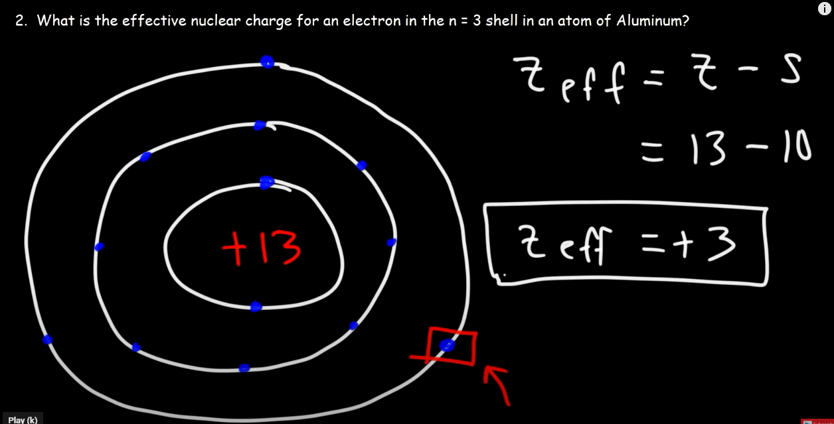

Slide 32
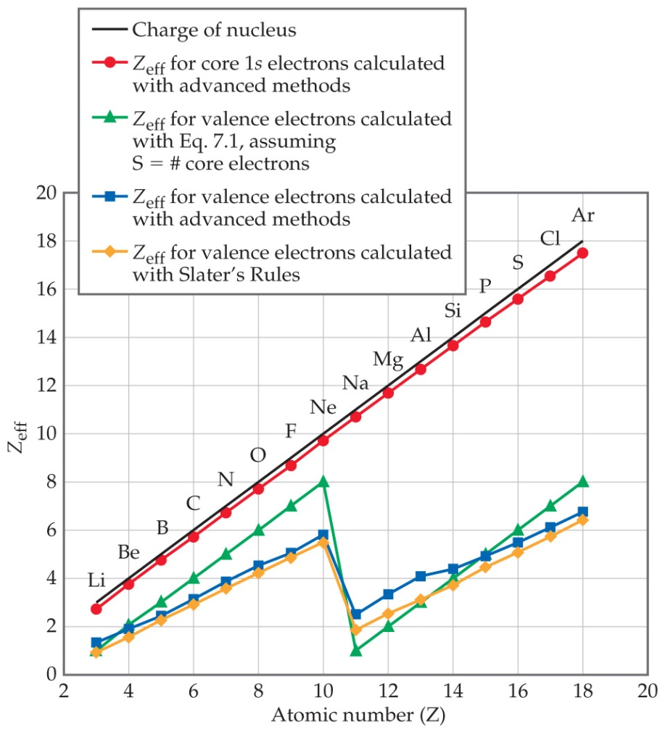
Effective Nuclear Charge Increases across a Period

Slide 33
Effective Nuclear Charge
The ENC felt by outermost electrons is smaller that that felt by inner electron because of screening effect by the inner electrons
The big drop (Ne-Na): core electrons are more effective than the valence electrons at screening the nuclear charge

Slide 34
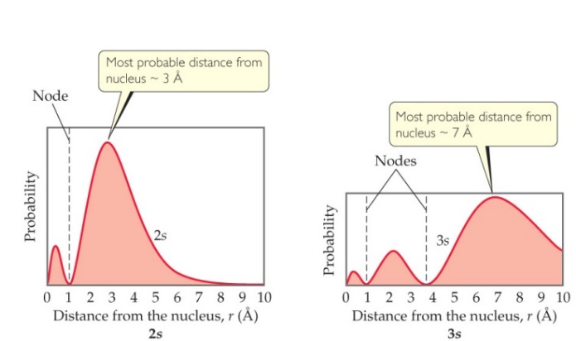

ENC
For many-electron atom, the energies of orbitals with same n value increases with l value
For example in carbon, a 2s electron is not screened as much by the core orbital as is a 2p electron (2s electron suffers greater attraction).
2s electron is lower in energy than the 2p electron

Slide 35
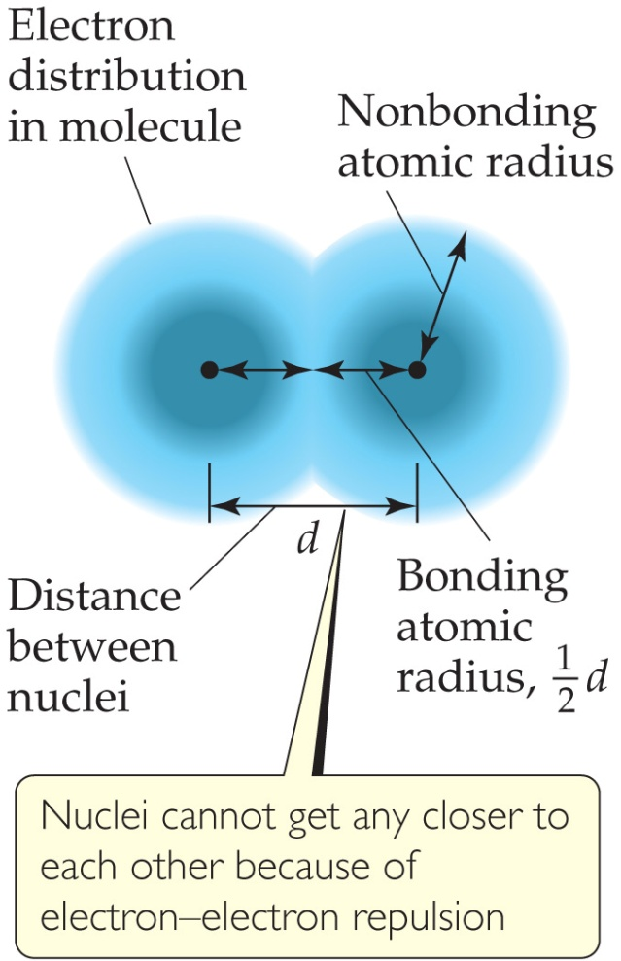
What Is the Size of an Atom?
The nonbonding atomic radius or van der Waals radius is half of the shortest distance separating two nuclei during a collision of atoms.

Slide 36

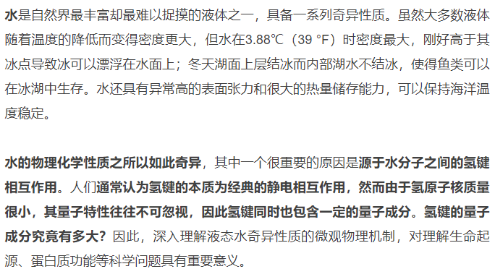
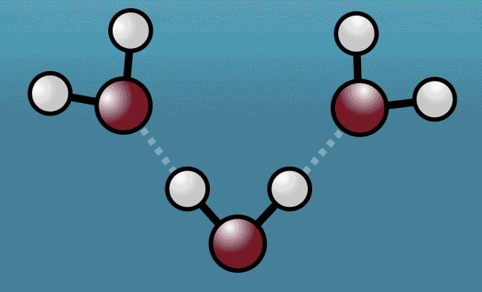
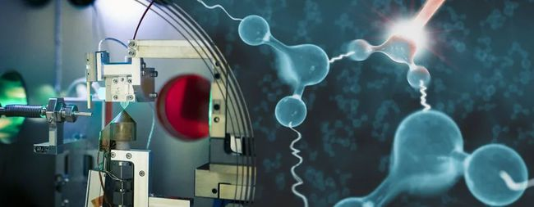
Notes:
Sweetening agent

Slide 37
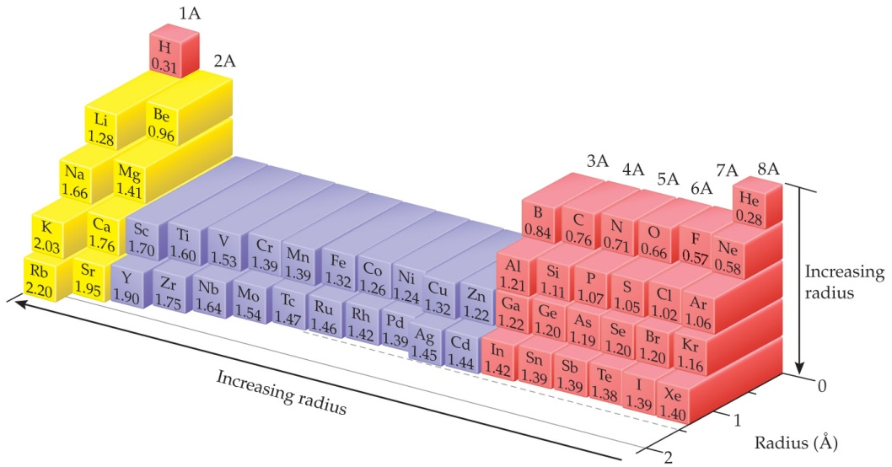
Sizes of Atoms
The bonding atomic radius is half the internuclear distance when atoms are bonded.
The bonding atomic radius tends to
— decrease from left to right across a period (Z_{eff} ↑).
— increase from top to bottom of a group (n ↑).

Slide 38
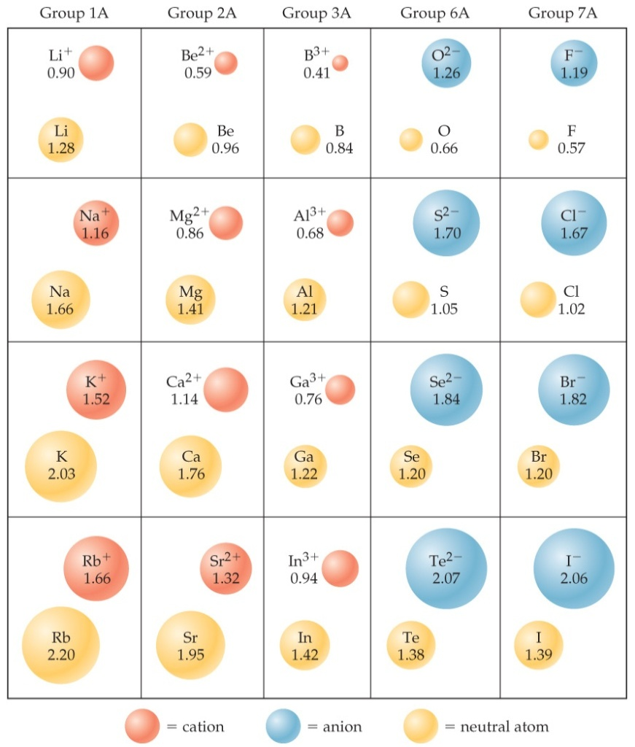
Sizes of Ions
Determined by interatomic distances in ionic compounds
Ionic size depends on
the nuclear charge.
the number of electrons.
the orbitals in which electrons reside.

Slide 39
Sizes of Ions
Cations are smaller than their parent atoms:
The outermost electron is removed and repulsions between electrons are reduced.
Anions are larger than their parent atoms:
Electrons are added and repulsions between electrons are increased.

Slide 40
Size of Ions— Isoelectronic Series
In an isoelectronic series, ions have the same number of electrons.
Ionic size decreases with an increasing nuclear charge.
An Isoelectronic Series (10 electrons)
Note increasing nuclear charge with decreasing ionic radius as atomic number increases
O^{2–} | F– | Na⁺ | Mg²⁺ | Al³⁺
1.26 Å | 1.19 Å | 1.16 Å | 0.86 Å | 0.68 Å

Slide 41
Ionization Energy (I)
The ionization energy is the minimum energy required to remove an electron from the ground state of a gaseous atom or ion.
The first ionization energy is that energy required to remove the first electron.
The second ionization energy is that energy required to remove the second electron, etc.
Note: the higher the ionization energy, the more difficult it is to remove an electron!

Slide 42
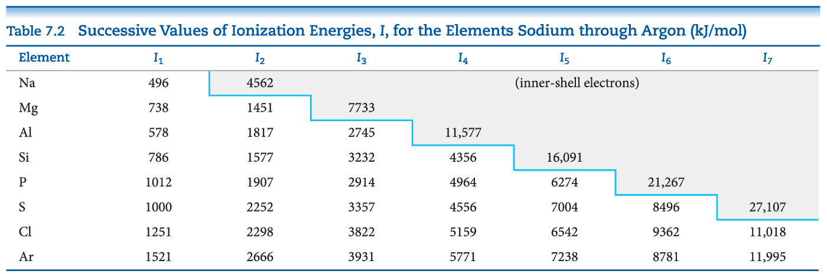
Ionization Energy
It requires more energy to remove each successive electron.
When all valence electrons have been removed, it takes a great deal more energy to remove the next electron.

Slide 43
Periodic Trends in First Ionization Energy (I₁)
I₁ generally increases across a period.
I₁ generally decreases down a group.
The s- and p-block elements show a larger range of values for I₁. (The d-block generally increases slowly across the period; the f-block elements show only small variations.)

Slide 44
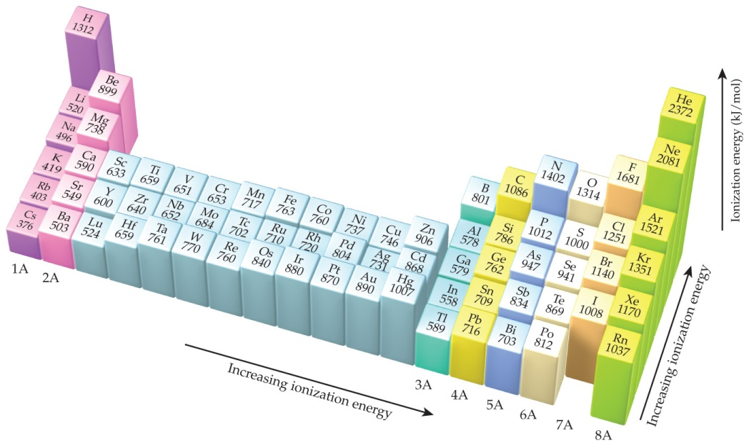
Factors that Influence Ionization Energy
Smaller atoms have higher I values.
I values depend on effective nuclear charge and average distance of the electron from the nucleus.

Slide 45
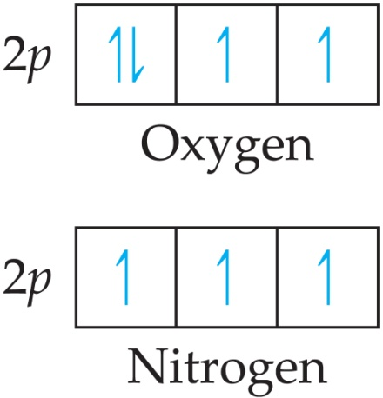
Irregularities in the General Trend
The trend is not followed when the added valence electron in the next element
enters a new sublevel (higher energy sublevel);
is the first electron to pair in one orbital of the sublevel (electron repulsions lower energy).

Slide 46
Electron Configurations of Ions
Cations: The electrons are lost from the highest energy level (n value).
Li⁺ is 1s² (losing a 2s electron).
Fe²⁺ is 1s²2s²2p⁶3s²3p⁶3d⁶ (losing two 4s electrons).
Anions: The electron configurations are filled to ns²np⁶; e.g., F– is 1s²2s²2p⁶ (gaining one electron in 2p).
Notes:
Fe26

Slide 48
Electron Affinity
Electron affinity is the energy change accompanying the addition of an electron to a gaseous atom:
Cl (g) + e⁻ ⎯⎯→ Cl⁻
It is typically exothermic, so, for most elements, it is negative!

Slide 49
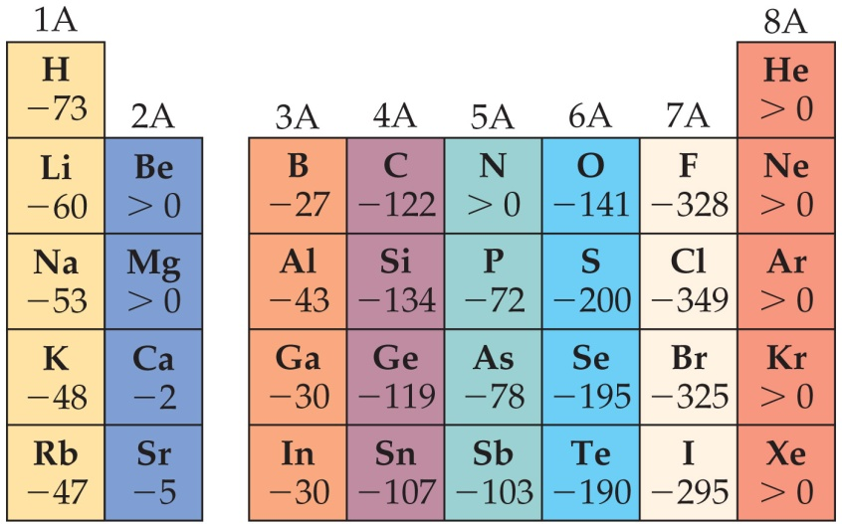
General Trend in Electron Affinity
Not much change in a group.
Across a period, it generally increases. Three notable exceptions include the following:
Group 2A: s sublevel is full!
Group 5A: p sublevel is half-full!
Group 8A: p sublevel is full!
Note: the electron affinity for many of these elements is positive (X– is unstable).

Slide 50
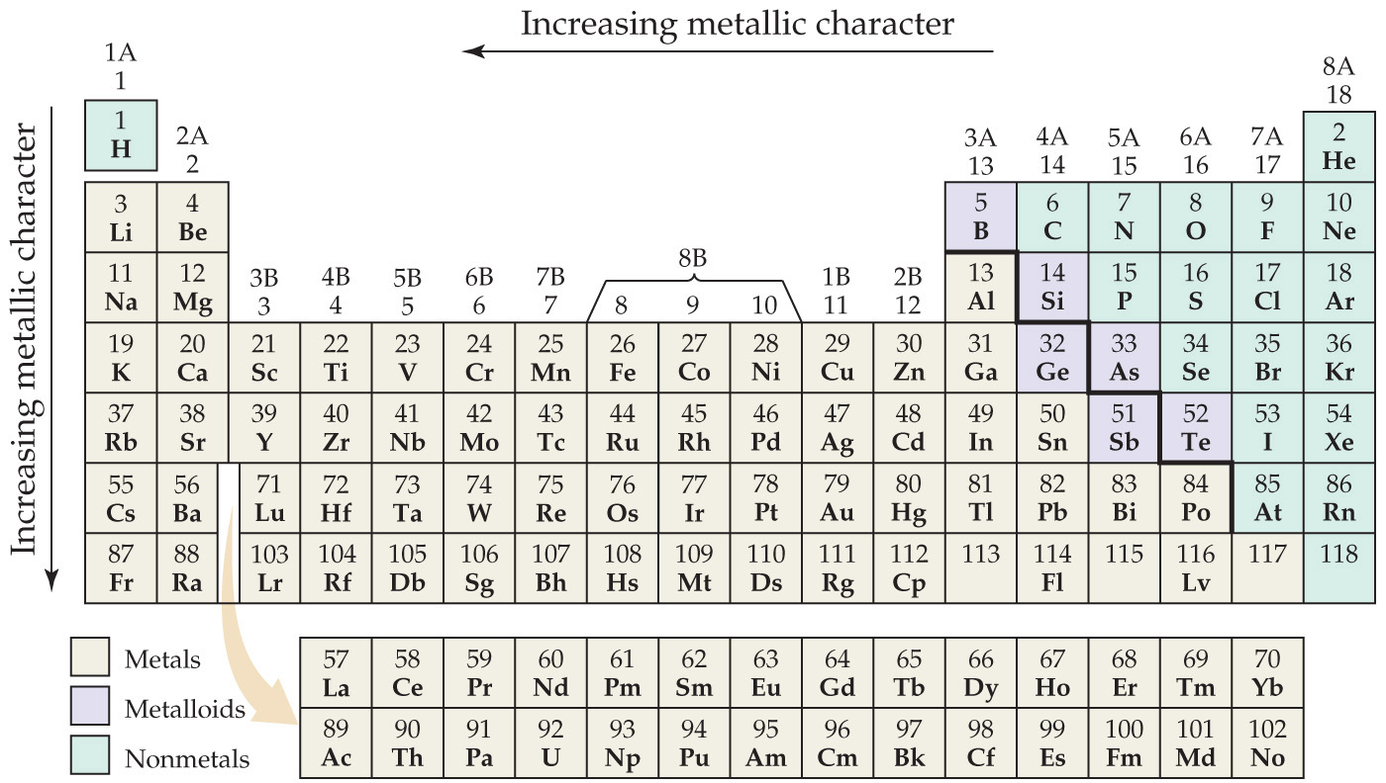
Metal, Nonmetals, and Metalloids

Slide 51
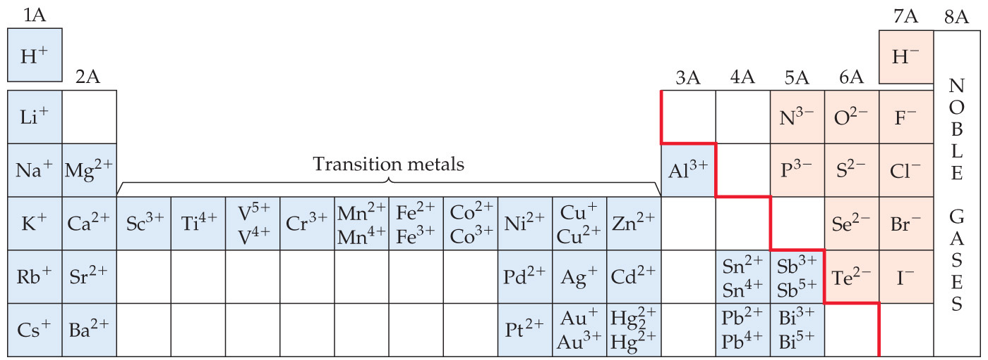
Metals Differ from Nonmetals
Metals tend to form cations.
Nonmetals tend to form anions.

Slide 52
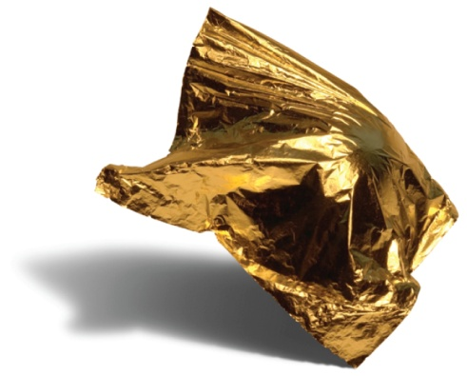
Metals
Most of the elements in nature are metals.
Properties of metals:
Shiny luster
Conduct heat and electricity
Malleable and ductile
Solids at room temperature (except mercury)
Low ionization energies/form cations easily

Slide 53
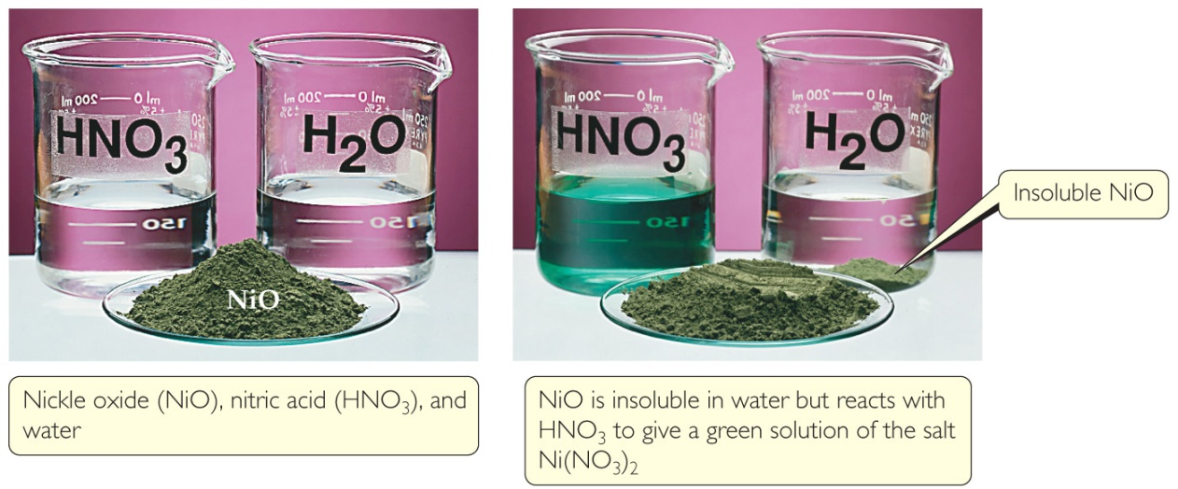
Metal Chemistry
Compounds formed between metals and nonmetals tend to be ionic.
Metal oxides tend to be basic.

Slide 54
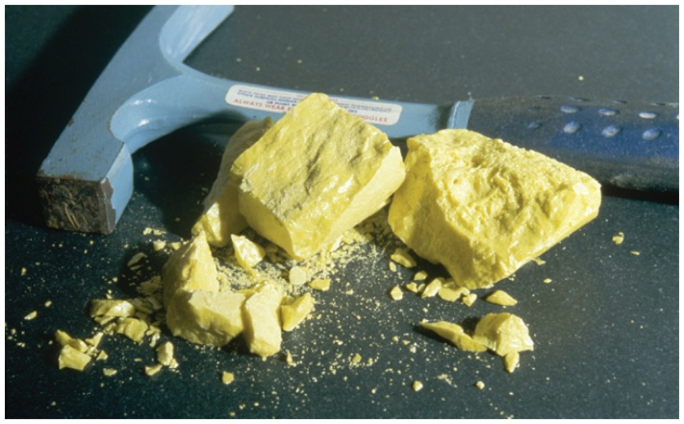
Nonmetals
Nonmetals are found on the right hand side of the periodic table.
Properties of nonmetals include the following:
Solid, liquid, or gas (depends on element)
Solids are dull, brittle, poor conductors
Large negative electronegativity/form anions readily

Slide 55
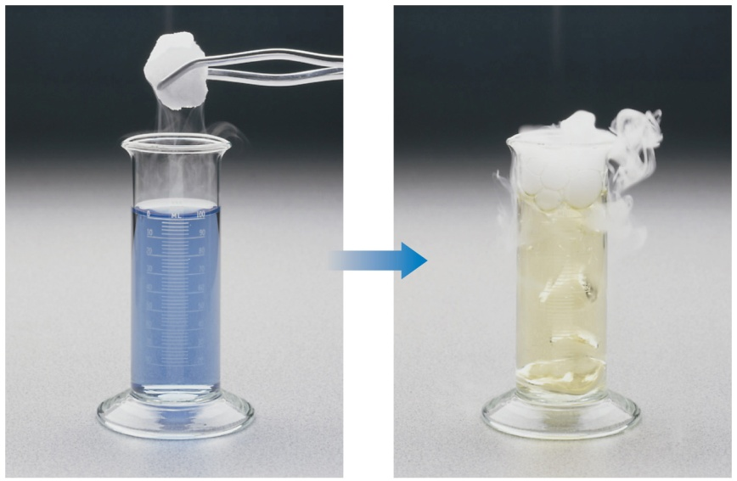
Nonmetal Chemistry
Substances containing only nonmetals are molecular compounds.
Most nonmetal oxides are acidic.

Slide 56
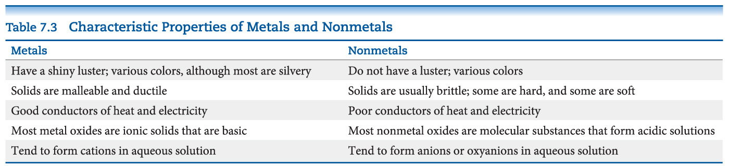
Recap of a Comparison of the Properties of Metals and Nonmetals

Slide 57
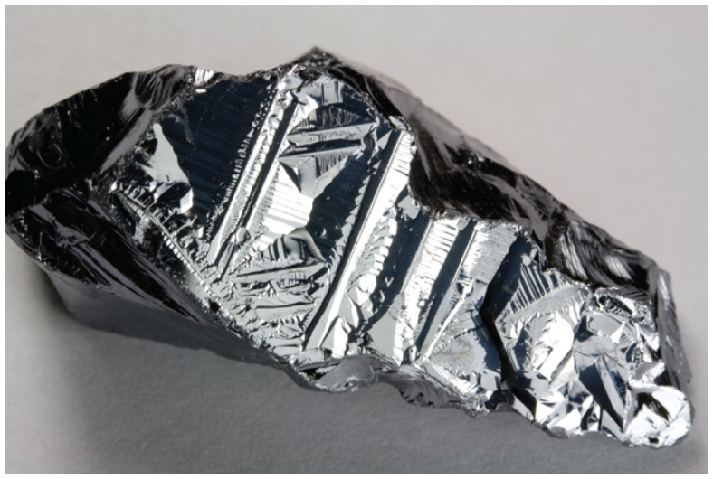
Metalloids
Metalloids have some characteristics of metals and some of nonmetals.
Several metalloids are electrical semiconductors (computer chips).

Slide 58
Group Trends
Elements in a group have similar properties.
Trends also exist within groups.
Groups Compared:
Group 1A: The Alkali Metals
Group 2A: The Alkaline Earth Metals
Group 6A: The Oxygen Group
Group 7A: The Halogens
Group 8A: The Noble Gases

Slide 59

Alkali Metals
Alkali metals are soft, metallic solids.
They are found only in compounds in nature, not in their elemental forms.
Typical metallic properties (luster, conductivity) are seen in them.

Slide 60
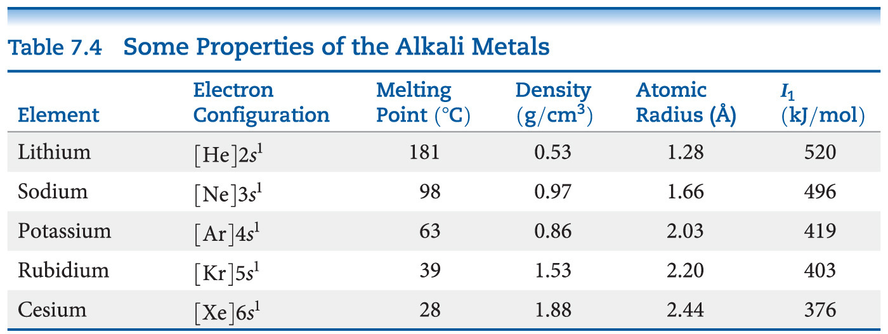
Alkali Metal Properties
They have low densities and melting points.
They also have low ionization energies.

Slide 61
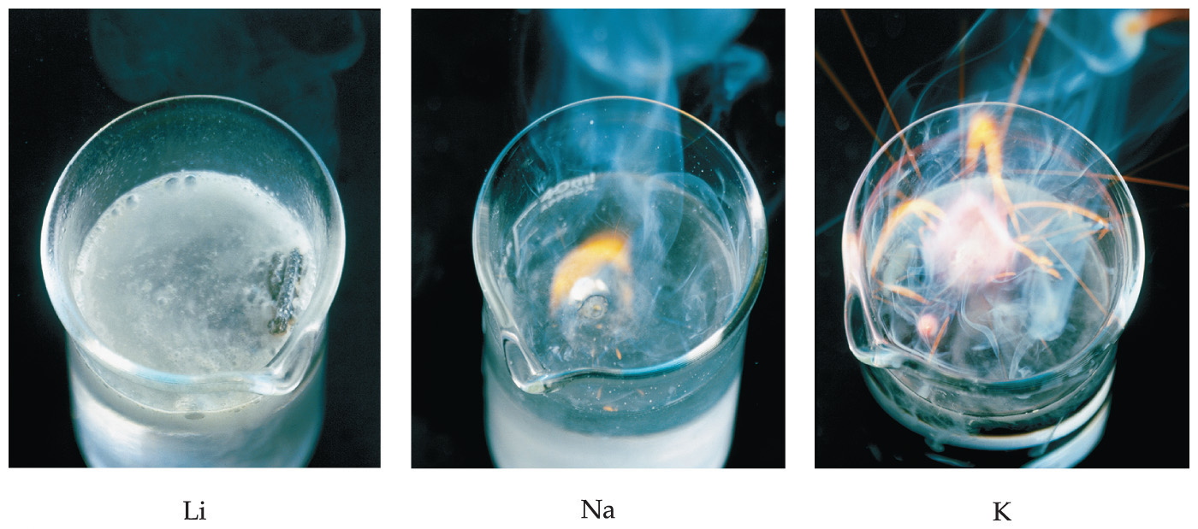
Alkali Metal Chemistry
Their reactions with water are famously exothermic.

Slide 62
Differences in Alkali Metal Chemistry
Lithium reacts with oxygen to make an oxide:
4 Li + O₂ ⎯⎯→ 2 Li₂O
Sodium reacts with oxygen to form a peroxide:
2 Na + O₂ ⎯⎯→ Na₂O₂
K, Rb, and Cs also form superoxides:
M + O₂ ⎯⎯→ MO₂

Slide 63
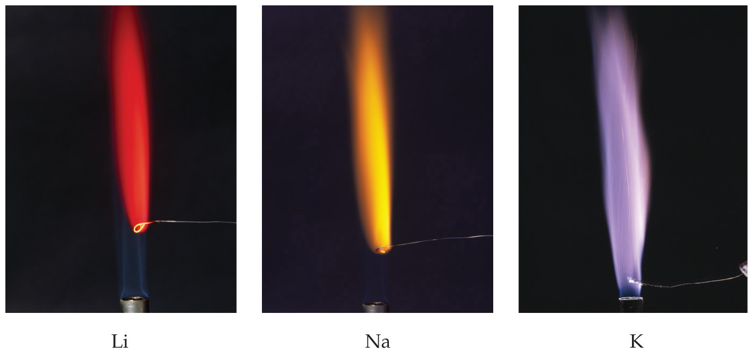
Flame Tests
Qualitative tests for alkali metals include their characteristic colors in flames.

Slide 64
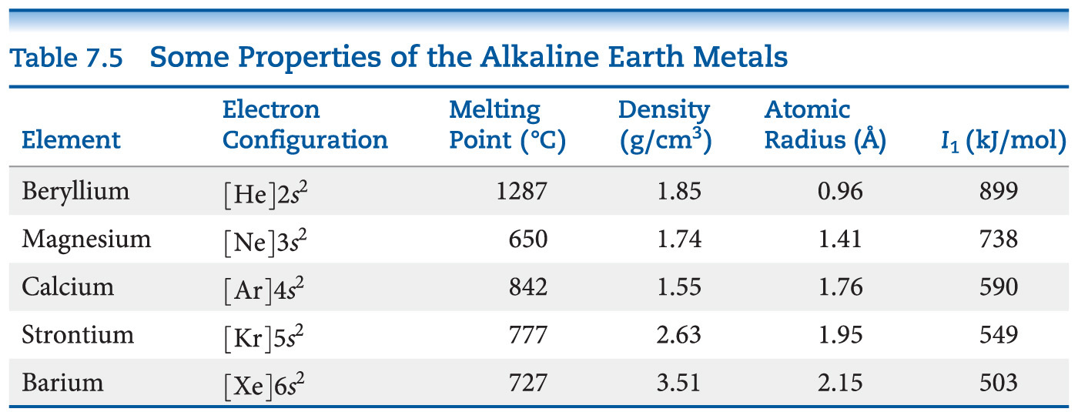
Alkaline Earth Metals—Compare to Alkali Metals
Alkaline earth metals have higher densities and melting points than alkali metals.
Their ionization energies are low, but not as low as those of alkali metals.

Slide 65
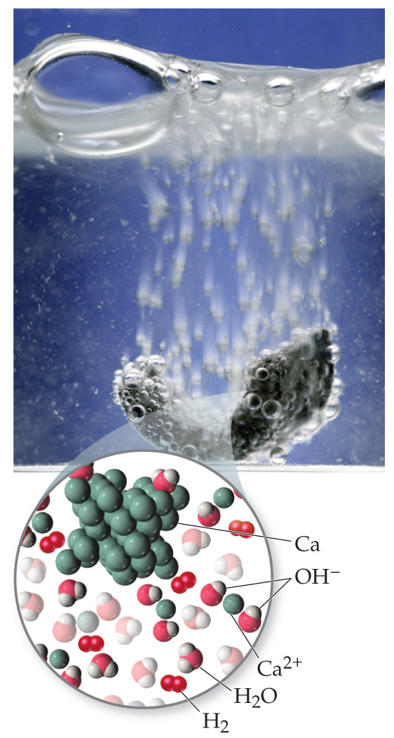
Alkaline Earth Metals
Beryllium does not react with water, and magnesium reacts only with steam, but the other alkaline earth metals react readily with water.
Reactivity tends to increase as you go down the group.

Slide 66

Group 6A—Increasing in Metallic Character down the Group
Oxygen, sulfur, and selenium are nonmetals.
Tellurium is a metalloid.
The radioactive polonium is a metal.

Slide 67

Group 7A—Halogens
The halogens are typical nonmetals.
They have highly negative electron affinities, so they exist as anions in nature.
They react directly with metals to form metal halides.

Slide 68

Group 8A—Noble Gases
The noble gases have very large ionization energies.
Their electron affinities are positive (can’t form stable anions).
Therefore, they are relatively unreactive.
They are found as monatomic gases.

